Slide 1
The Last Dance
Exploring the Impact of Real-Time Collaborative Code Editors in Developers’
Productivity

Slide 2
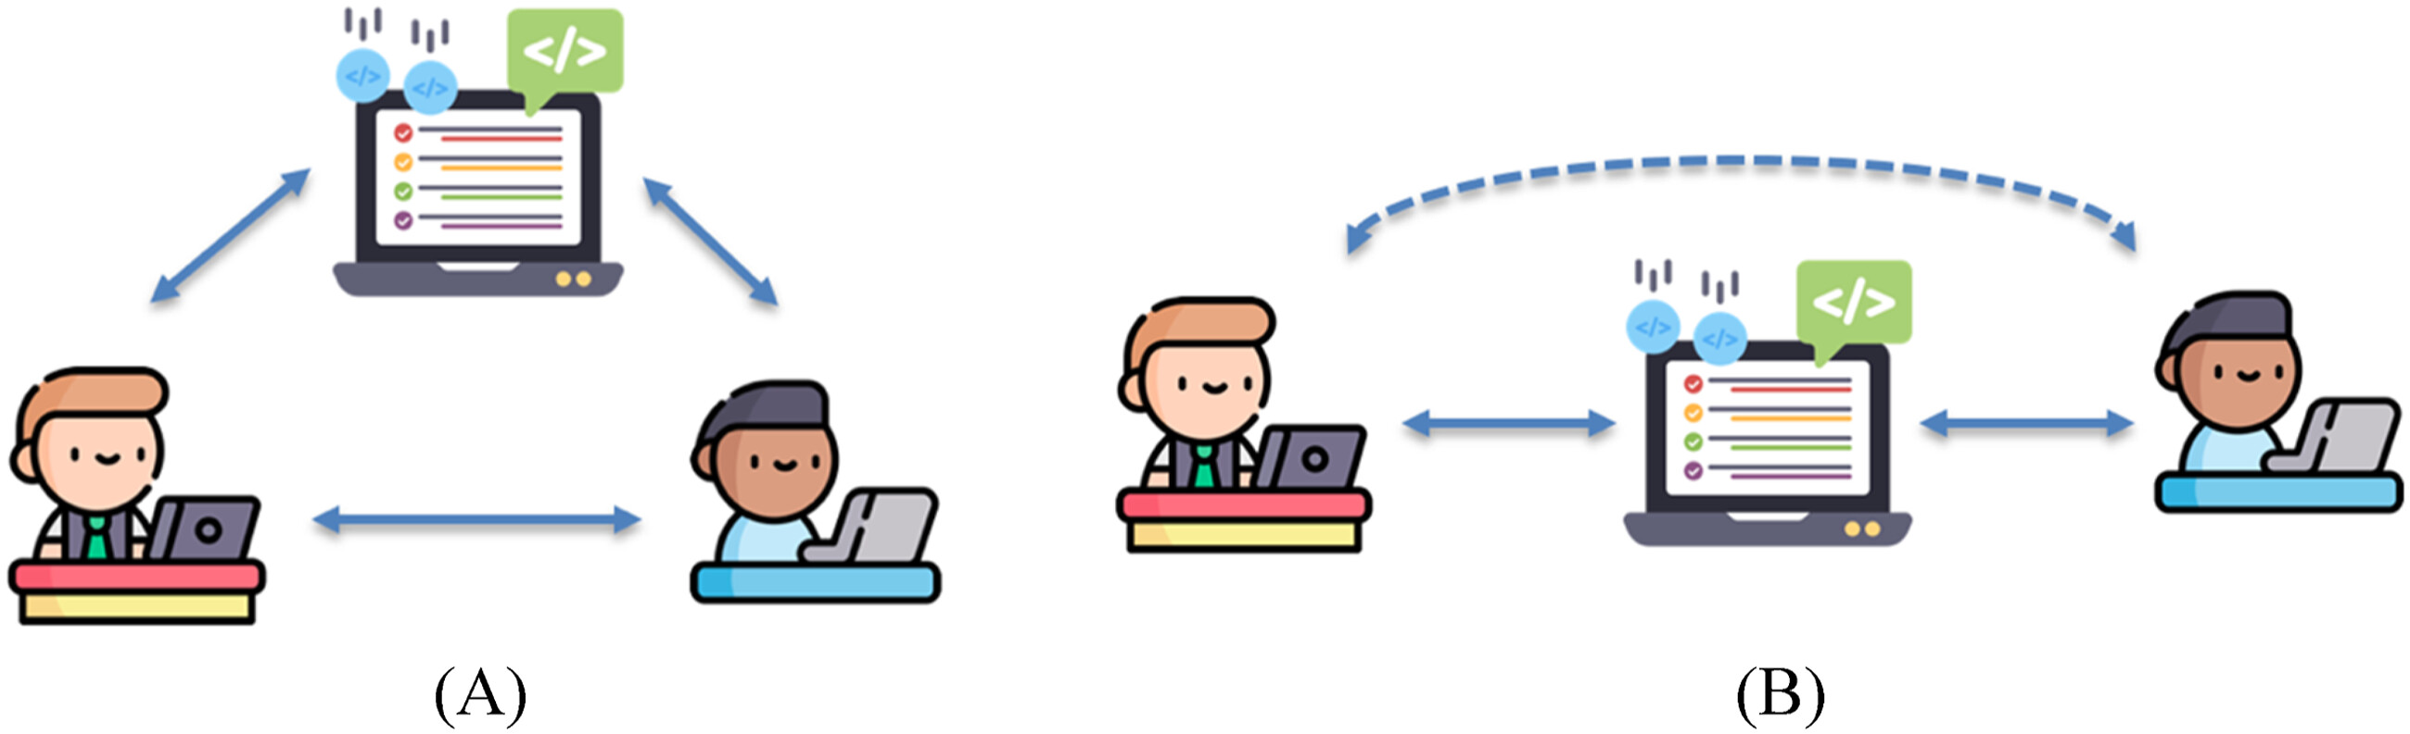
Introduction and motivation
Growing need for remote and collaborative software development tools
Rise of real-time collaborative code editors (e.g. VS Code Live Share, Replit)
Personal experience with teamwork challenges during group projects
Relevance to modern software practices and developer productivity

Slide 3
The Main Aim and Academic Question My Project Addresses
Academic Question: An investigation into the impact of real-time collaborative code editors on developers’ productivity.
Aims:
Assess how real-time collaborative coding environments influence productivity.
Compare real-time collaboration with asynchronous coding workflows.
Identify key metrics such as debugging speed, efficiency in code synchronization, and developer satisfaction.

Slide 4
History of Collaborative editing systems
The origin of collaborative coding can be traced back to the earliest days of software engineering, where cooperation among developers was largely managed manually. But this came with significant challenges such as Lack of structured methods for version tracking causing developers to struggle to maintain consistency across shared codebases. Issues like these fueled the development of early version control systems such as Concurrent Versions System (CVS) and later Subversion (SVN). These systems, although with their faults, provided a slight fix to the earlier issues. Platforms like GitHub and GitLab later followed, adding social coding features like pull requests, issue tracking, and continuous integration, revolutionizing the way teams collaborated. Then in the early 2000s real-time collaborative editing gained momentum with the introduction of software such as MoonEdit and SubEthaEdit, these introduced multi-user cusors and real-time text synchronization. Since then, many variations of have then been released like codePen, Codeanywhere, VS Live share etc.

Slide 5
Benefits and Challenges of Real-Time Collaborative Coding
Benefits | Challenges
Enhanced Productivity | Conflict Resolution Complexity
Improved Communication | Cognitive Overload
Higher Code Quality | Dependency on Network Stability
Faster Knowledge Transfer

Slide 6
Comparison Between Real-Time and Asynchronous Collaboration
Feature | Real-Time Collaborative Coding | Asynchronous Coding
Speed | Instant updates, no waiting for merges | Delayed updates, dependent on review cycles
Communication | Live discussion and code-sharing | Discussions occur via comments or messages
Conflict Resolution | Uses OT/CRDTs for synchronization | Merge conflicts must be manually resolved
Debugging Efficiency | Faster, as multiple developers can troubleshoot at once | Slower, requires feedback cycles
Scalability | Ideal for small-to-medium teams | More suited for larger teams working independently

Slide 7
My Report
I approached writing this report with a combination of different methodologies i.e. quantitative research and quantitative research to provide a well-rounded evaluation of the topic.
The qualitative aspect involved a comprehensive literature review on collaborative coding and technologies that make it possible as well as a reflective analysis of the artefact development and a comparative analysis of real-time development against asynchronous development.
Then complementing this was the quantitative aspect that focused on structured experiments(referenced), where metrics such as task completion time, collaboration fluidity, and synchronization responsiveness were measured across real-time and asynchronous collaboration settings. The dual approach allowed the report to leverage the strengths of each approach to gain a more comprehensive and nuanced understanding of a research topic.

Slide 8
My Artefact
For my artefact I built a lightweight real-time collaborative code editor, for this I used the MERN stack:
MongoDB (though unused in the final version),
Express.js for the server,
React for the frontend, and
Node.js as the runtime.
For real-time functionality, I used WebSockets through the Socket.IO library. I chose websocket over other alternatives because it offers a persistent, bidirectional connection that fits perfectly for sending real-time code changes.

Slide 9
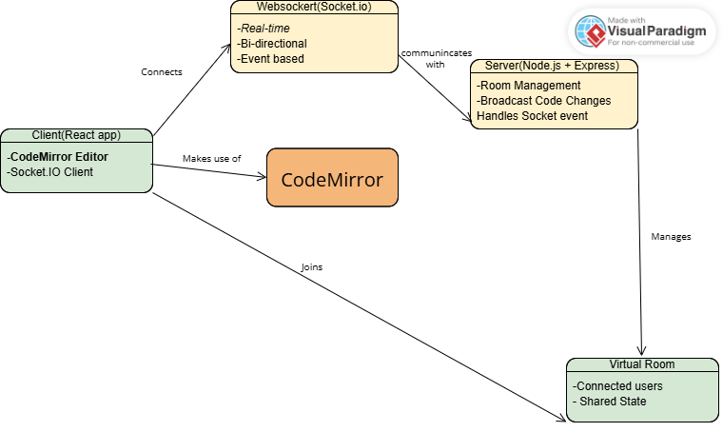
UML Diagram of My Artefact

Slide 10
What I would do differently
Looking back, if I were to approach this project differently, I would make a few changes. For the artefact I would do the following;
Implement Operational Transformation (OT) to better handle simultaneous edits.
Adding a chat room and ability to create a room with room id and passwords.
Include CodeMirror for the editor component because of its flexibility and responsiveness.
And for the report I would do the following;
Include more quantitative research and conducted more experiments and testing to get better accuracy.
Research-led planning, I made a lot of my decisions concerning my report based on the direction/plan I had in mind rather that approaching this with a more flexible mindset and allowing the research guide me. Doing this would have gotten me a stronger report.

